Slide 1
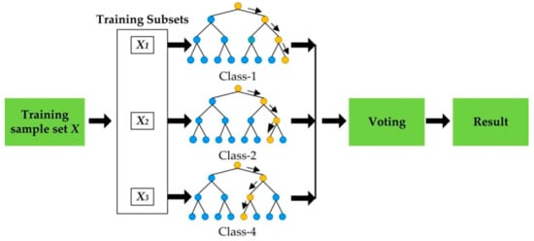
Random forest
Notes:
Source: https://www.youtube.com/watch?v=ZVR2Way4nwQ

Slide 2
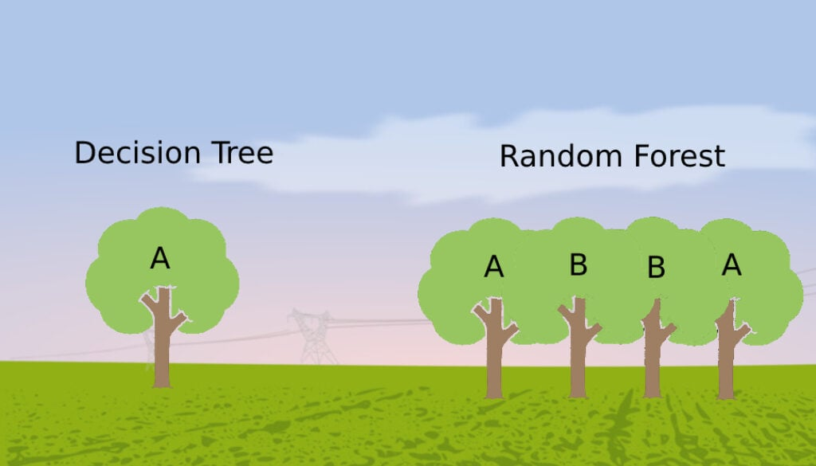
Decision Tree vs Random Forest

Slide 3
Random Forest step-by-step
Selection of Subset: Bagging starts by choosing a random sample, or subset, from the entire dataset, with the same number of rows.
Row Sampling: Each dataset is then filled with original rowdata. The step of row sampling with replacement is referred to as bootstrapping.
Random Feature Selection: from each dataset we randomly select a subset of features for each tree and use only them for training.
Independent Model Training: Each model is trained independently on a different bootstrapped dataset with random features. This training process generates results for each model.
Aggregation: The final output is determined by combining the results of all models through majority voting or averaging.

Slide 4
Random Forest step-by-step
Selection of Subset: Bagging starts by choosing a random sample, or subset, from the entire dataset, with the same number of rows.
Row Sampling: Each dataset is then filled with original rowdata. The step of row sampling with replacement is referred to as bootstrapping.
Sample
id | x0 | x1 | x2 | x3 | y
1 | 4,3 | 7,6 | 1,8 | 3,6 | 0
2 | 5,5 | 5,9 | 2,1 | 3,2 | 1
3 | 6,8 | 8,4 | 2,9 | 4,1 | 0
4 | 5,9 | 9,6 | 1,5 | 2,5 | 1
id | x1 | x..
2
2
1
3
id | x..
1
2
4
4
id | x..
4
2
1
1
Train
Test
1 | 4.3 | 2.1 | 2.9 | 4.1 | 1
Bootstrapping
Notes:
With replacement means we put the same number in the dataset to choose from that makes it possible that

Slide 5
Random Forest step-by-step
Random Feature Selection: from each dataset we randomly select a subset of features for each tree and use only them for training.
id | x..
2
2
1
3
id | x..
1
2
4
4
id | x..
4
2
1
1
x0,x3
x1,x2
x1,x3

Slide 6
Random Forest step-by-step
id | x..
2
2
1
3
id | x..
1
2
4
4
id | x..
4
2
1
1
Independent Model Training: Each model is trained independently on a different bootstrapped dataset with random features. This training process generates results for each model.
x0,x3
x1,x2
x1,x3
x3≤3.6
x2≤5.9
x1≤7.6
x0≤4.3
1
1
0
1
x3≤2.5
0
1
0
1
Notes:
If you use every feature then most of your trees will have the same decision nodes and will act very similarly. This will increase the variance (overfit)

Slide 7
Random Forest step-by-step
id | x..
2
2
1
3
id | x..
1
2
4
4
id | x..
4
2
1
1
Aggregation: The final output is determined by combining the results of all models through majority voting or averaging. The most commonly predicted outcome among the models is selected, majority voting.
x0,x3
x1,x2
x1,x3
x3≤3.6
x2≤5.9
x1≤7.6
0
1
0
1
1
x0 | x1 | x2 | x3
4.3 | 2.1 | 2.9 | 4.1
x0≤4.3
1
1
x3≤2.5
Test
0
1
0
1
Prediction:
1
0
1
Majority vote: 1
Notes:
Bootstrapping makes the model less sensitive to the original traiing data. Random feature selection helps to reduce the correlation between the trees.
If you use every feature then most of your trees will have the same decision nodes and will act very similarly. This will increase the variance (overfit)
Log or sqrt of number of features is the best numer for the amount of feature selection in this case 5 features 2 is close to the root of 5

